Slide 1
The Undercover Federales: Feel the Burn (or Not?)!
DU Data Visualization Project 1 (APIs)
Justin Potts
Jessie Hanson
Mohamed Abdi
Rich Whittington

Slide 2

We all wear sunscreen, right?
(You should!)
It makes sense that exposure to sunlight would be associated with exposure to solar radiation, right? The more sunlight, the more radiation.
We looked at a dataset to see if there was a data-provable relationship between the amount of sunlight a location receives and the amount of solar radiation measureable.

Slide 3


The Hypothesis
If the amount of daylight represents the amount of solar radiation for a region,
Then we expect to see a correlation between amount of daylight and the amount of solar radiation measure in each city.
Let’s Find Out! Brace yourselves for data!

Slide 4
We pulled our data from Weatherbit.io.
(Yeah, we know, but it was free.)
And then wrote
some code to see
what was going on.
Tip
When using Jupyter Notebook, you have to have your “config” file named “config.py” or else Jupyter will not acknowledge it.
(Time lost: 48 minutes)

Slide 5
The Code
for i,city in enumerate(cities):
city_data = requests.get(url).json()
try:
lat = city_data["data"][0]["lat"]
temp = city_data["data"][0]["temp"]
solar_rad = city_data["data"][0]["solar_rad"]
…*some code abridged*
except:
print("missed " + city)
cities_df.head(6)
Summary
We called the API and made a loop that fetched the specific items from the JSON--lat, long, temp, etc. These results were sent to a list, arranged in a dataframe and saved to a CSV file.

Slide 6
The Code
def timeDiff(sunrise, sunset):
if (sunrise > 0 and sunset > 0):
# Convert the integer sunrise and sunset to actual date-time #variables
rise = datetime.datetime.fromtimestamp(sunrise)
set = datetime.datetime.fromtimestamp(sunset)
rise = sunrise
sset = sunset
fmt = '%Y-%m-%d %H:%M:%S'
# This converts to date/time objects
d1 = datetime.datetime.strptime(rise, fmt)
d2 = datetime.datetime.strptime(sset, fmt)
# compute the number of minutes between the two dates
diff = d2 - d1
return ((diff.days * 24 * 60) + (diff.seconds/60))
# else:
# return (0)
Tip
Joe knows lots of cool code.
Ask him for help.
Summary
We made variables for the sun’s journey and converted those variables from timestamps into date-time objects and then converted to minutes.

Slide 7
Plots! (On our own.)
We each took the CSV file and
cleaned, sorted, and analyzed our own
portion of the globe.
Tip
GitHub hates your soul and it will win. Resistance is futile.
JaeJun can help.
Time lost: 106 minutes
Tip
GrubHub loves your soul and it delivers.
Tip your driver.
Time saved: 53 minutes

Slide 8
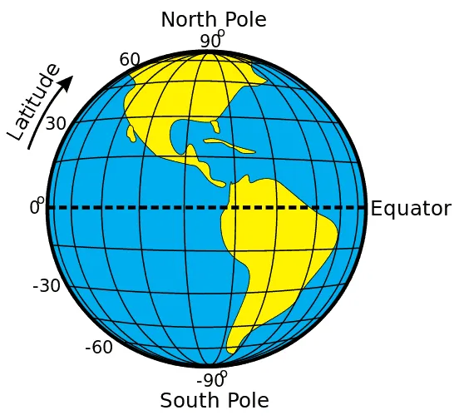
We split the globe into four quadrants and each took a portion.
Teamwork:
Justin:
0 to 45
Jessie:
45 to 90
Mohamed:
0 to -45)
Rich
-45 to -90

Slide 9
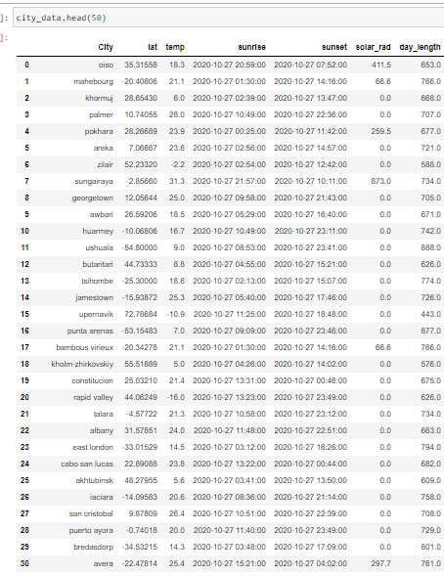
The Data
The dataset we called from the API was...sketchy. And required cleaning.
Aching Absence We had a lot of values returned as “0.0” for the “Solar Radiation” call.
What We Paid For Was nothing. Which means that we could only call one specific moment in time, not historic or cumulative data.
What We Did
We cleaned the “0.0” values from the data and worked with the remainder.

Slide 10
The Code
Grab the files & make into DF
city="cities.csv"
city_data=pd.read_csv(city)
len(city_data)=635
Get rid of 0.0 values
city_data_clean=city_data[(city_data['solar_rad']>0.0)]
city_data_clean=city_data_clean.reset_index()
len(city_data_clean)=234
Grieve the loss of all those data points
It’s ok. We’ll work with what we have.
Tip
Make sure you import all the dependencies that you need into your new notebook when you copy and paste from previous work.
Time lost: 32 minutes

Slide 11
The Code
Slice up the world and remove the data that does not correspond to 0-45 degrees latitude (or whatever quadrant was examined).
city_data_clean=city_data_clean[(city_data_clean['lat']>45) & (city_data_clean['lat']<90)]
city_data_clean=city_data_clean.reset_index()
city_data_clean
See what’s left (for top quadrant)
len(city_data_clean)=53
Grieve the loss of all those data points
It’s ok. We’ll work with what we have.
Tip
Make sure you rerun the code from the top each time you change something significant.
Time lost: 12 minutes

Slide 12
Jessie
Took the “top” quadrant of the globe, a definition determined by historic biases against the Southern Hemisphere.
45 to 90 degrees

Slide 13
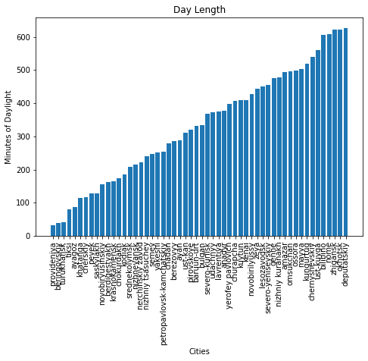
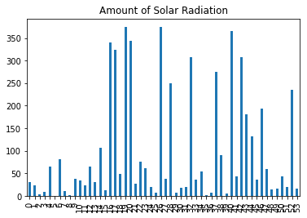
We plotted the length of the days, the latitude, and amount of solar radiation.
Even within the “top” quadrant of the globe, there is a lot of variation in the length of the day and the amount of solar radiation.
Tip
MatPlotLib is hard.
Don’t let anyone tell you otherwise.

Slide 14
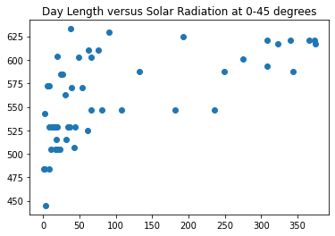
The plot of day_length versus solar_radiation was expected to show a strong correlation
Summary
The correlation is underwhelming.

Slide 15
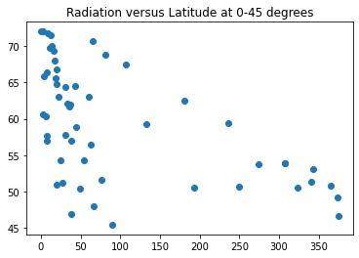
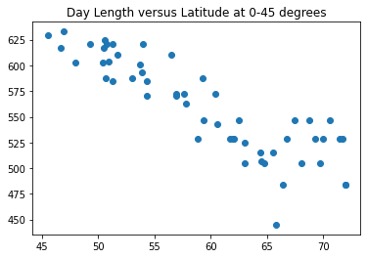
Let’s look at latitude versus solar_radiation and versus day_length.
Summary
As latitude decreases, radiation increases.
As latitude decreases, day length increases.

Slide 16
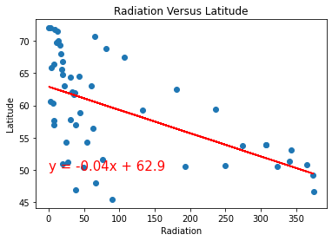
Here’s radiation versus latitude, with a line.
Summary
As latitude decreases, radiation increases.
Linear regression emphasizes this.

Slide 17
Justin
Took the “upper middle” quadrant of the globe, a definition determined by historic biases against the Southern Hemisphere.
0 to 45 degrees

Slide 18
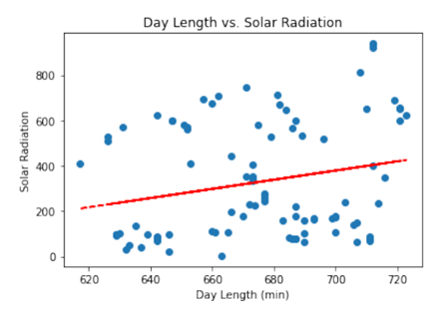
The “upper middle” quadrant also failed to overwhelm with day_length versus solar_radiation.
Notes:
The low r-squared indicates almost no linear relationship between the 2 variables. The amount of solar radiation emitted has no bearing on the length of day due to daylight.

Slide 19
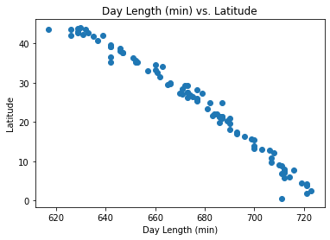
But the relationship between day_length and latitude ftw.
Summary
Day length and radiation show no clear relationship.
But day length and latitude show a strong correlation.
Notes:
From this data you can clearly see the relationship between when Latitudes are higher the day lengths are shorter. The lower the latitude the length of daylight increases by over 100 minutes between 0 and 45 degrees latitude.

Slide 20
Mohamed
Took the “lower middle” quadrant of the globe, a definition determined by historic biases against the Southern Hemisphere. (0 to -45 degrees)

Slide 21
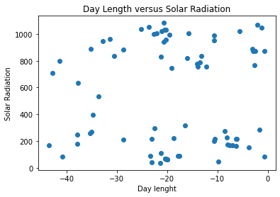
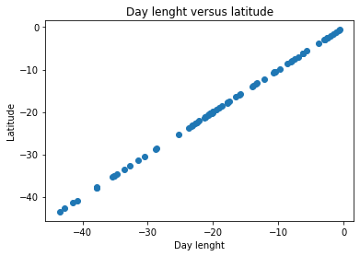
When comparing day length and Solar radiation between 0 and -45 degrees we see that there is no correlation.
Latitude and Day Length between 0 and -45 degrees do have a strong correlation.

Slide 22
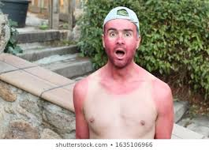
This revelation is shocking.
My assumption was the longer the day, the more solar radiation a city would receive.

Slide 23
Rich
Took the “lowest” quadrant of the globe, a definition determined by historic biases against the Southern Hemisphere. (-45 to -90 degrees)

Slide 24
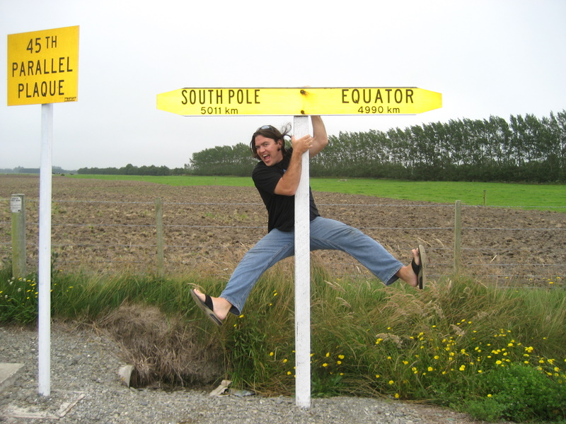
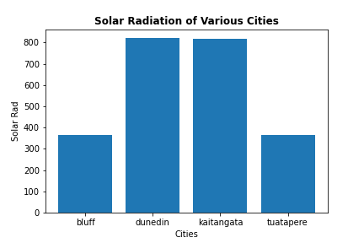
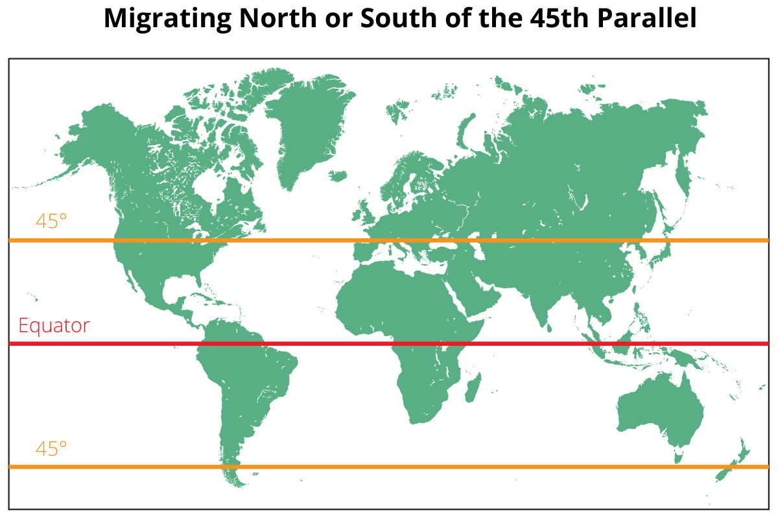
Rich
Mohamed
Perfect Bell Curve!

Slide 25
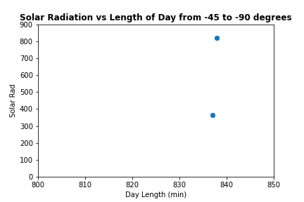
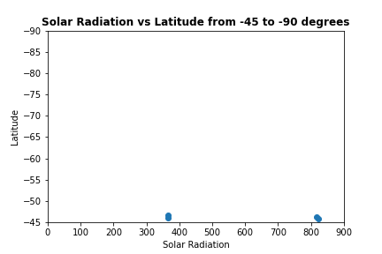

Slide 26
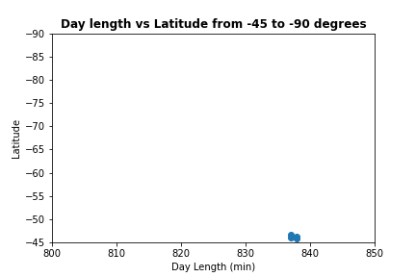
Tip
Review the data before assigning quartiles.

Slide 27
In Conclusion
We expected the data to support the hypothesis that more minutes of daylight would correspond to more solar radiation. However,
It did not
We reject the hypothesis
We did not find a correlation between minutes of daylight and solar radiation.
But we find an interesting relationship There does appear to be a strong correlation between latitude and radiation.

Slide 28
Considerations of the Data
We could only pull one moment of data--which leaves half the world in darkness. This could be why we had so many 0.0 values for solar_radiation to clean.
There may not be complete data available from every locations--some may have thermometers, but not radiation-measurement devices. Our lack of complete data could also be attributed to this.
Cities are not evenly-distributed. They cluster in some quadrants, and so the data isn’t weighted evenly.
Interpret results with caution

Slide 29
Thanks for Watching!
We had fun working on this project and we hope you enjoyed thinking about how the sun fries us into our inevitable deaths!
Tip
When writing your hypothesis, don’t get too attached to the outcome. The data may not support it and you’ll have to change your mind.

